Slide 1
1/f Noise Decoupling
Sangyeon Lee
Seoul National Univ.
QDL (Quantum Device LAB. at SNU)
Prof. Eunjong Kim
Date: 2024.02.02

Slide 2
Contents
Pink Noise
CP CPMG UDD Pulse
Bloch-Redfield Approach
Pink Noise Decoupling (Not yet)
https://github.com/BrainConnection/QuTiP

Slide 3
Pink Noise

Slide 4
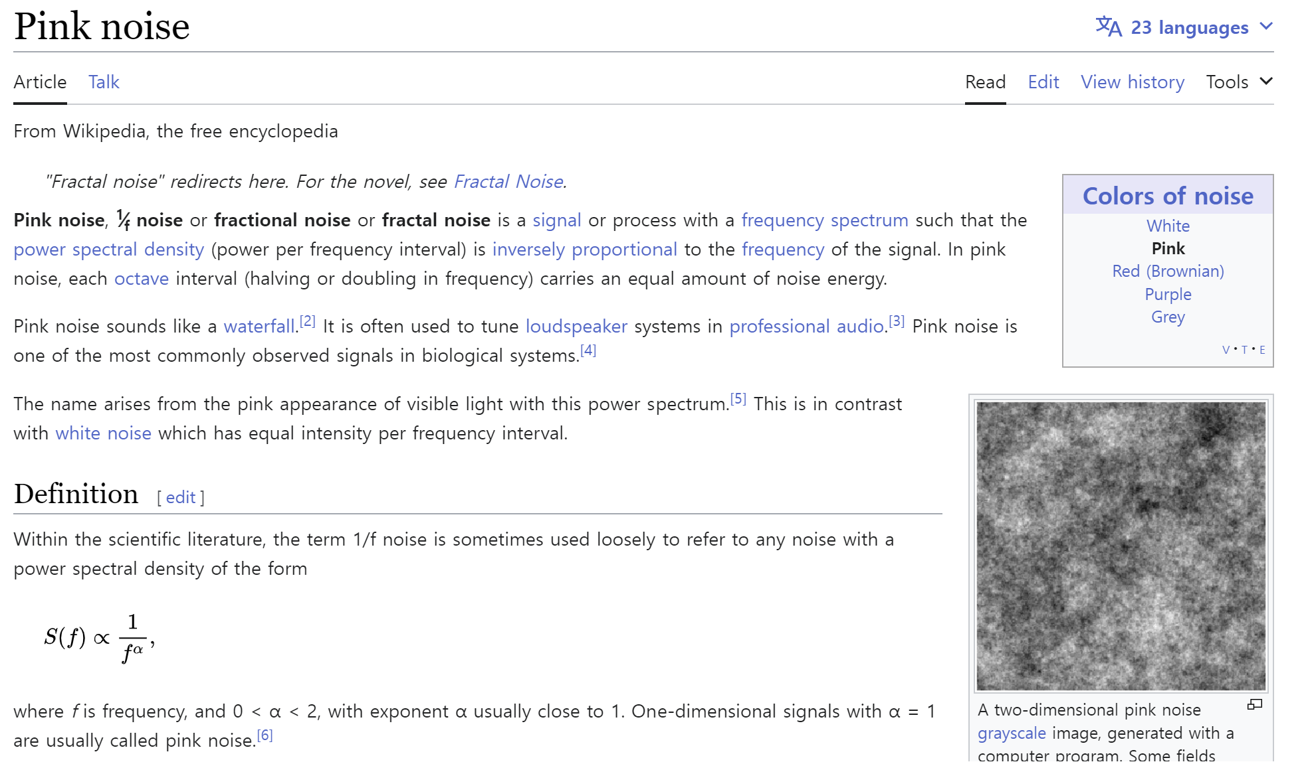
Pink Noise

Slide 5
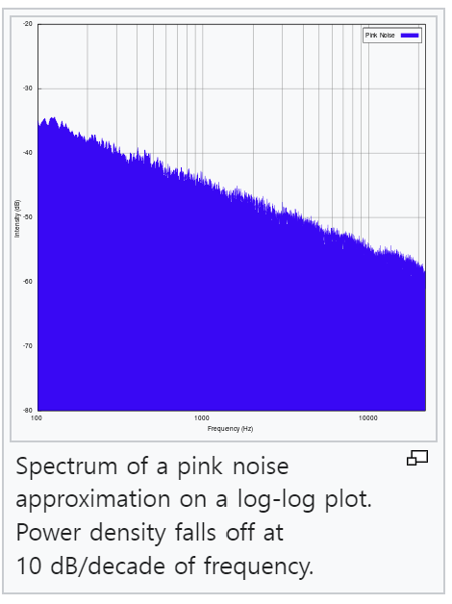
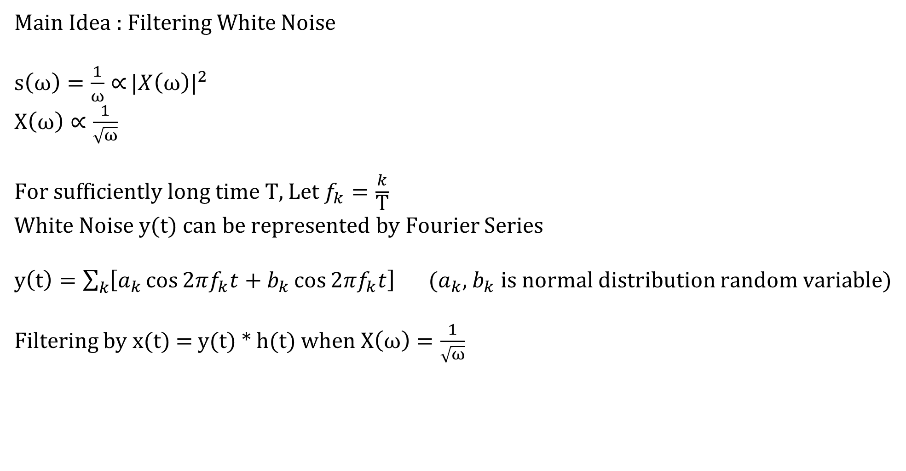
Pink Noise
Main Idea : Filtering White Noise
$s\left(ω\right)=\frac{1}{ω}∝{{|X\left(ω\right)|}^{2}}$
$X\left(ω\right)∝\frac{1}{\sqrt{ω}}$
For sufficiently long time T, Let $f_{k}=\frac{k}{\text{T}}$
White Noise y(t) can be represented by Fourier Series
$y\left(t\right)=\sum_{k}{\left[a_{k}\cos{2πf_{k}t}+b_{k}\cos{2πf_{k}t}\right]}$ ($a_{k}$, $b_{k}$ is normal distribution random variable)
Filtering by x(t) = y(t) * h(t) when $X\left(ω\right)=\frac{1}{\sqrt{ω}}$

Slide 6
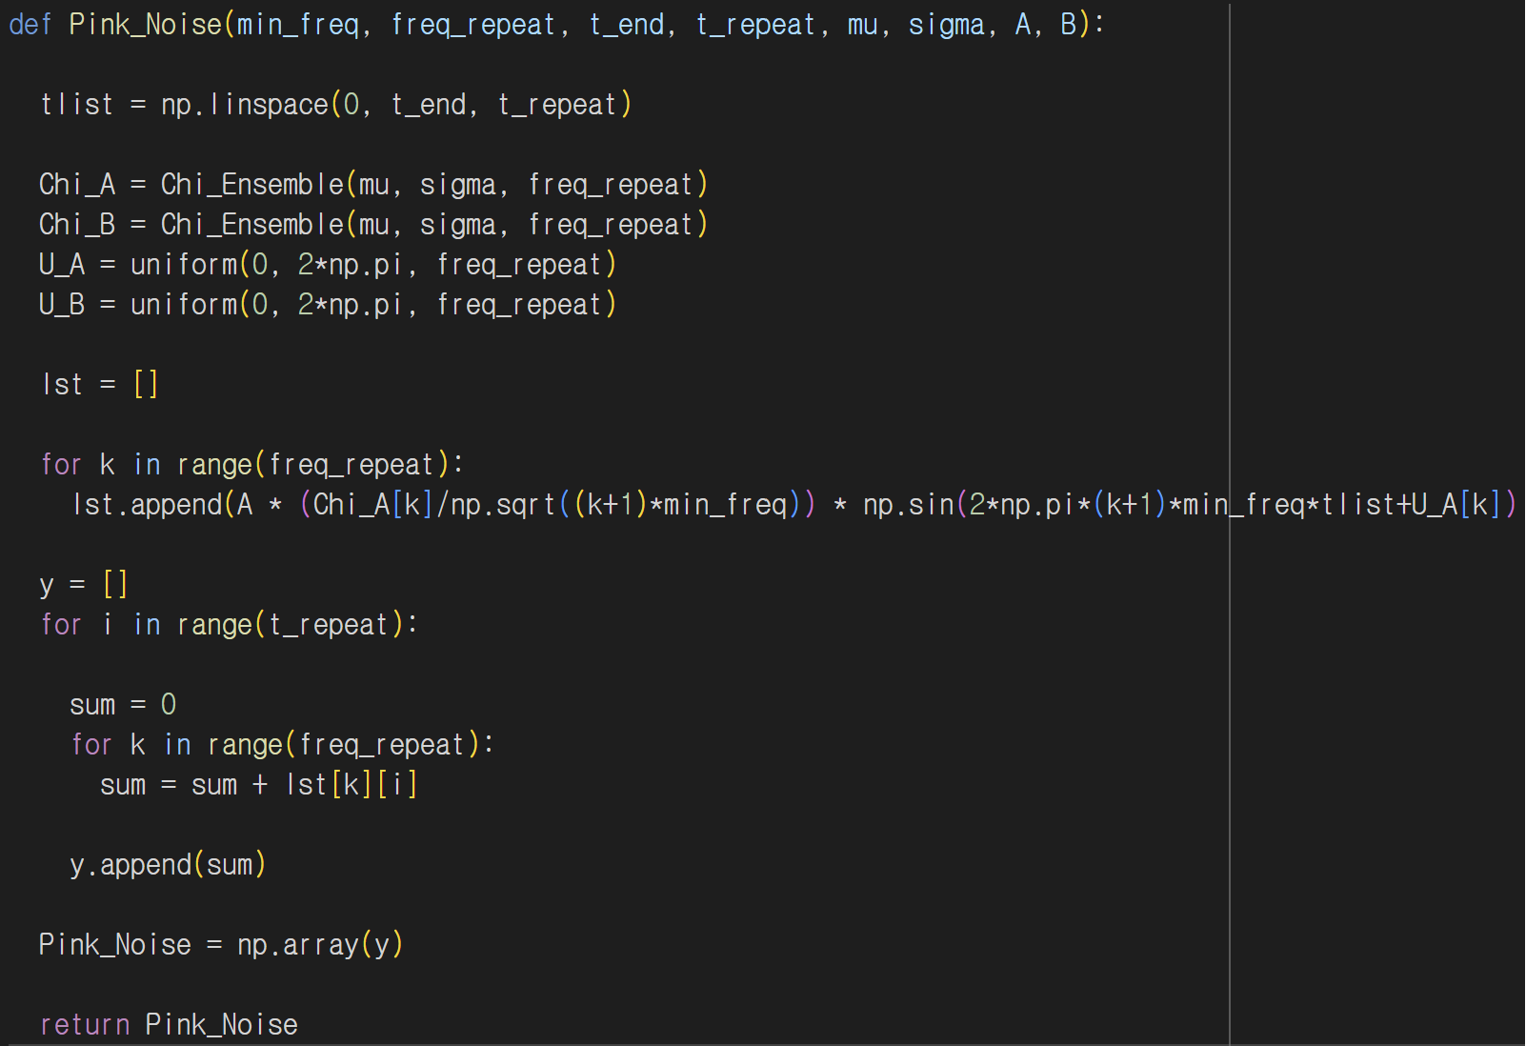
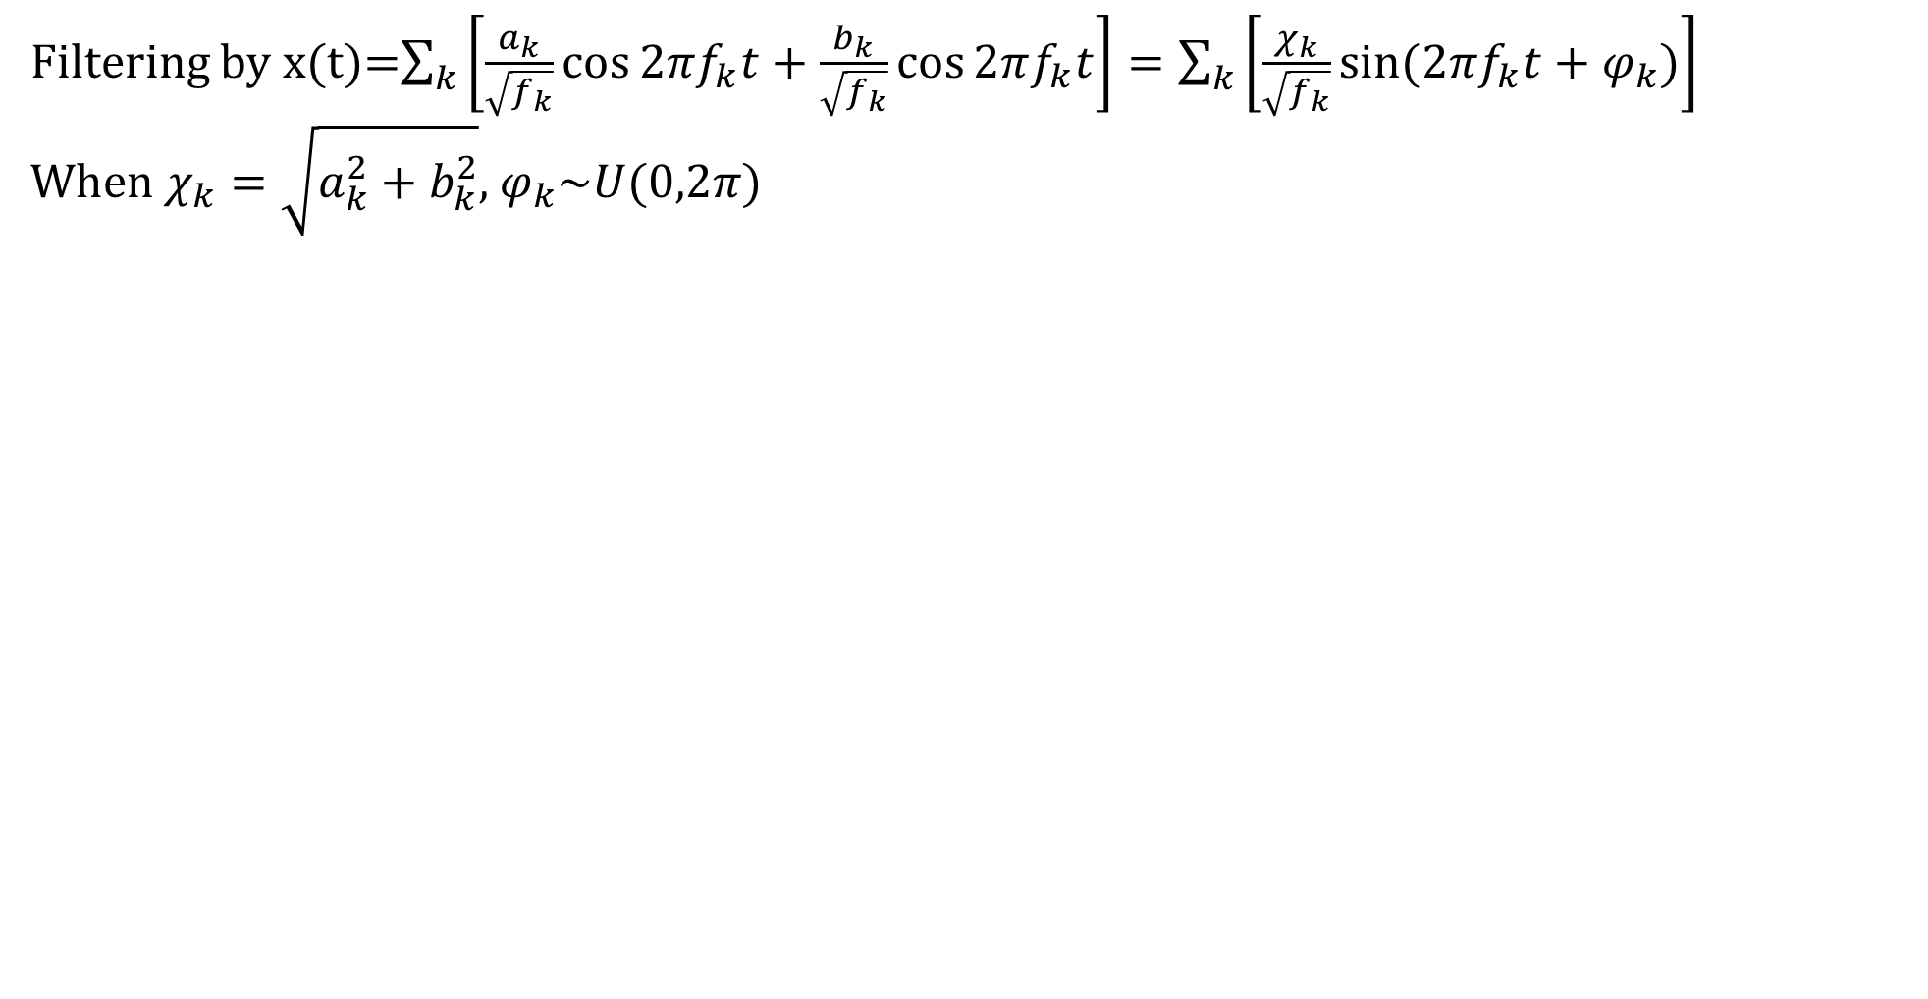
Pink Noise
Filtering by x(t)=$\sum_{k}{\left[\frac{a_{k}}{\sqrt{f_{k}}}\cos{2πf_{k}t}+\frac{b_{k}}{\sqrt{f_{k}}}\cos{2πf_{k}t}\right]=\sum_{k}{\left[\frac{χ_{k}}{\sqrt{f_{k}}}\sin{(2πf_{k}t+φ_{k})}\right]}}$
When $χ_{k}=\sqrt{a_{k}^{2}+b_{k}^{2}}$, $φ_{k}\sim U(0,2π)$

Slide 7
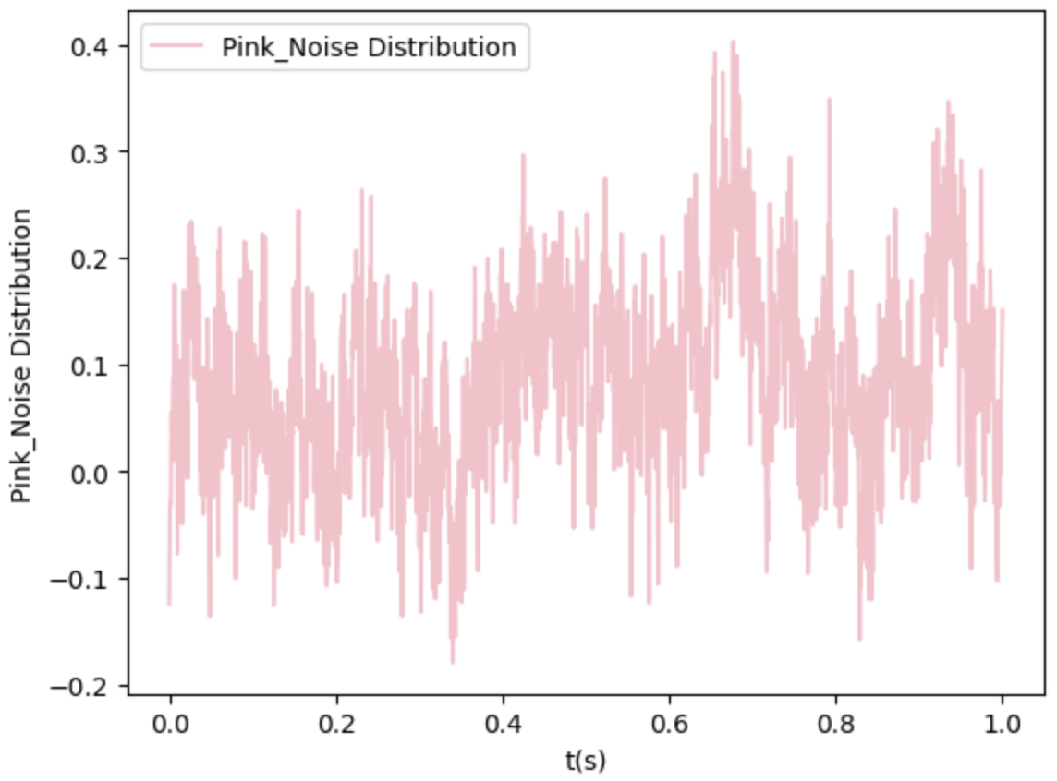
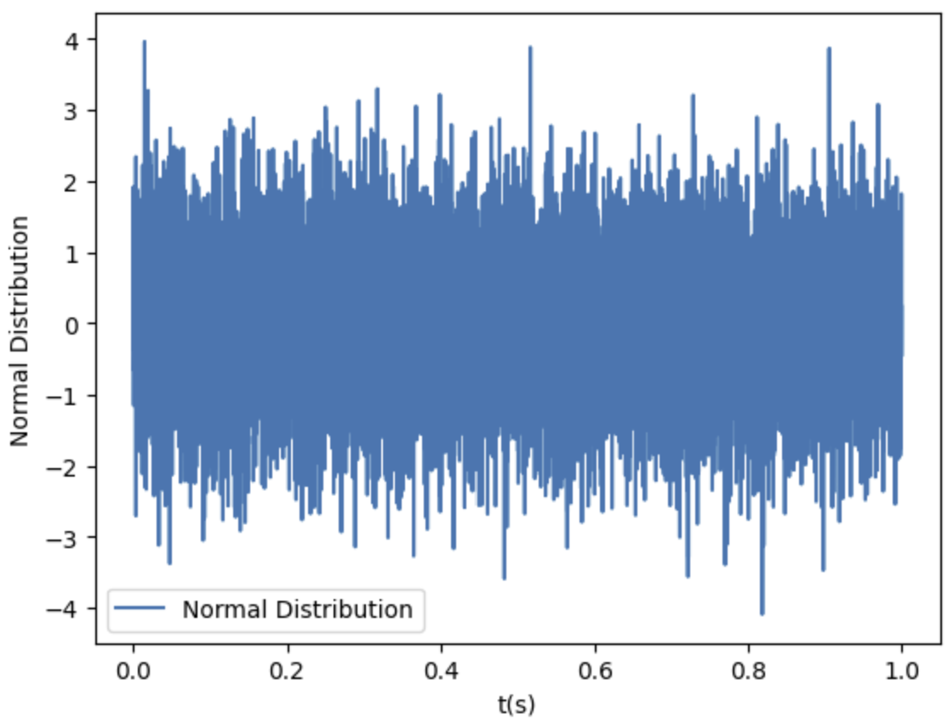
Pink Noise

Slide 8
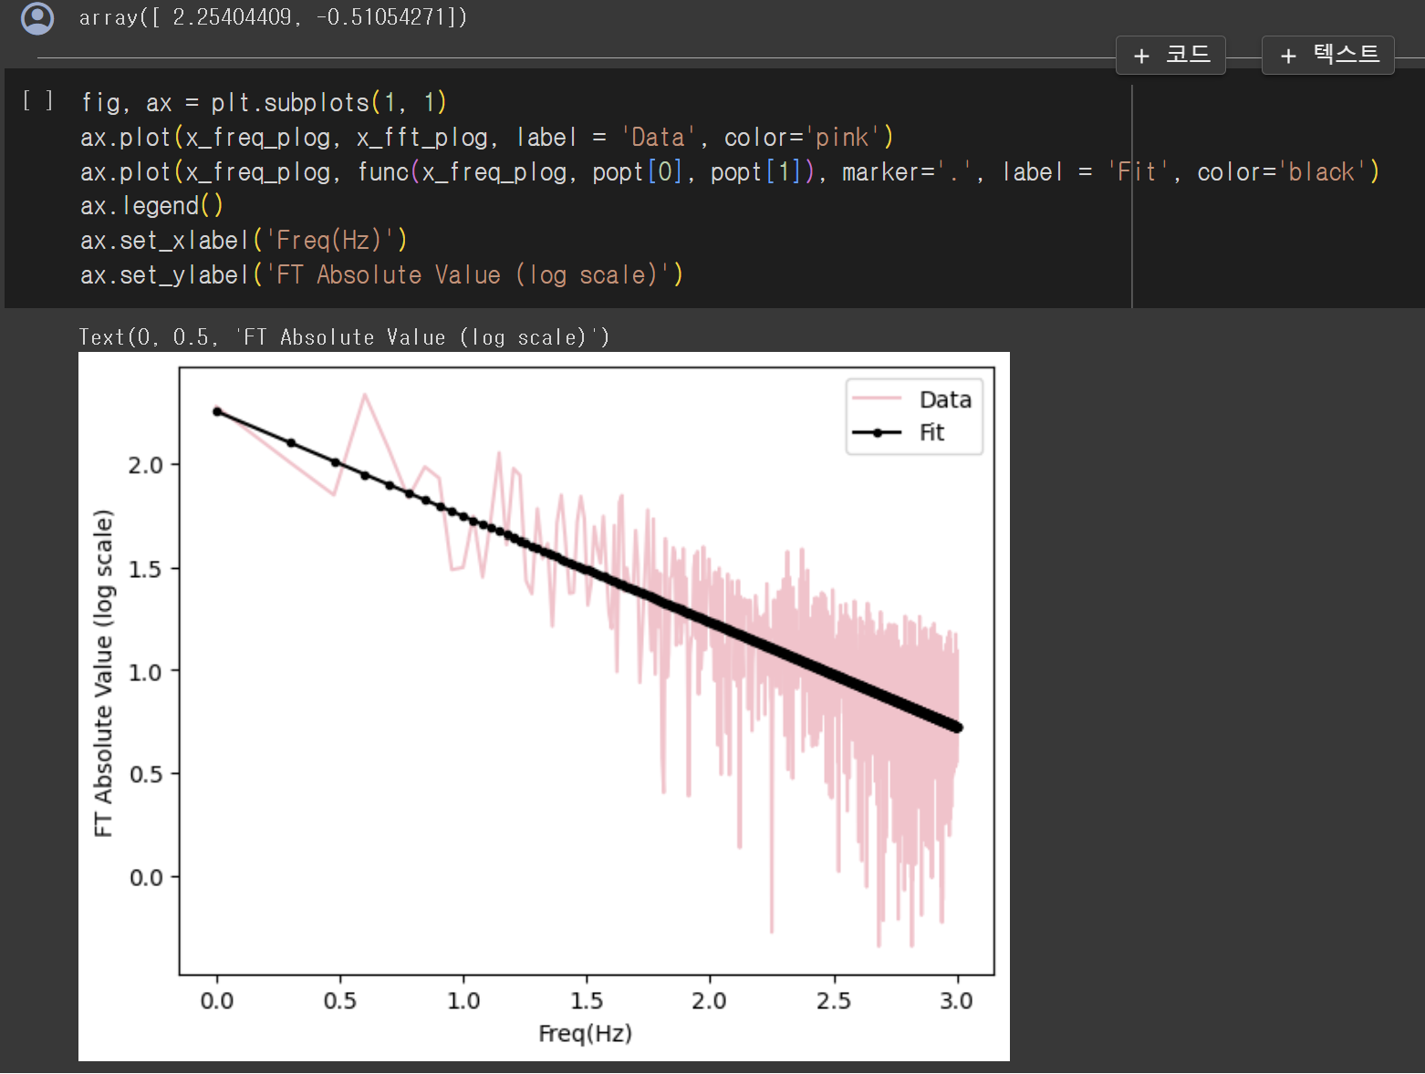
Pink Noise

Slide 9
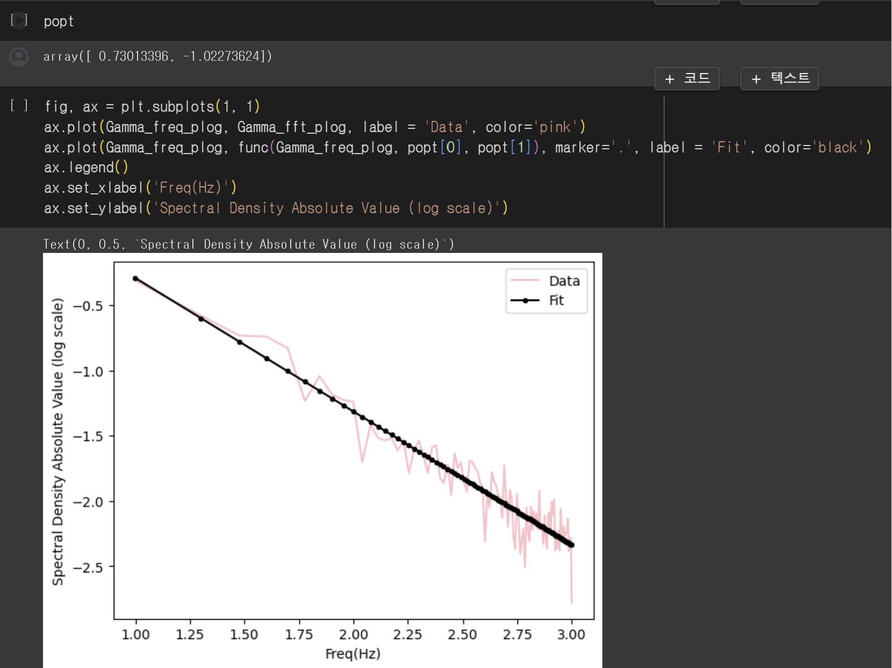
Pink Noise

Slide 10
CP CPMG UDD Pulse

Slide 11
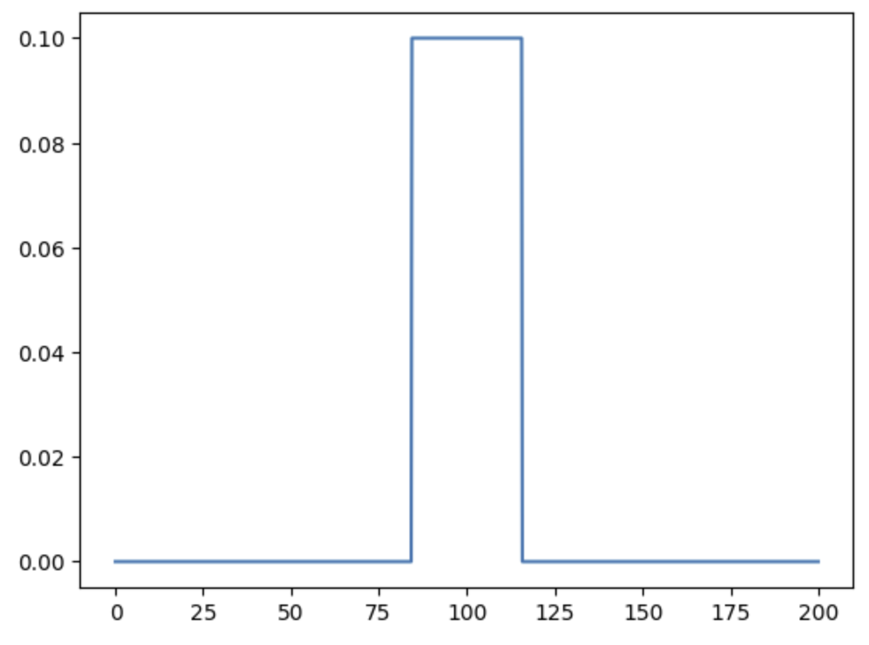
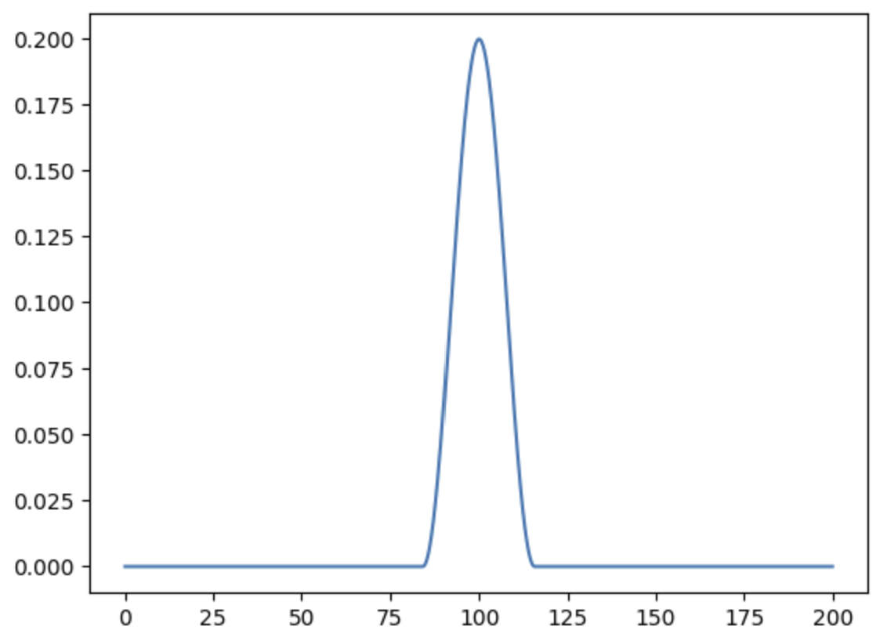
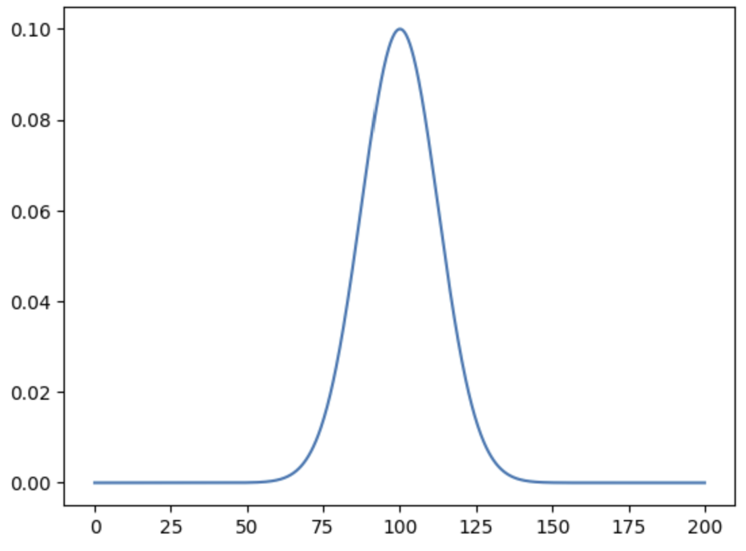
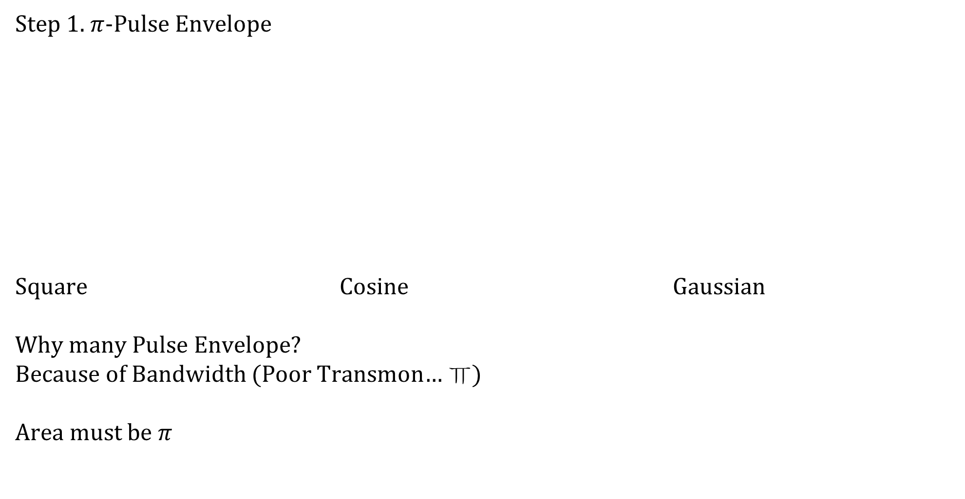
CP CPMG UDD Pulse
Step 1. $π$-Pulse Envelope
Square Cosine Gaussian
Why many Pulse Envelope?
Because of Bandwidth (Poor Transmon… ㅠ)
Area must be $π$

Slide 12
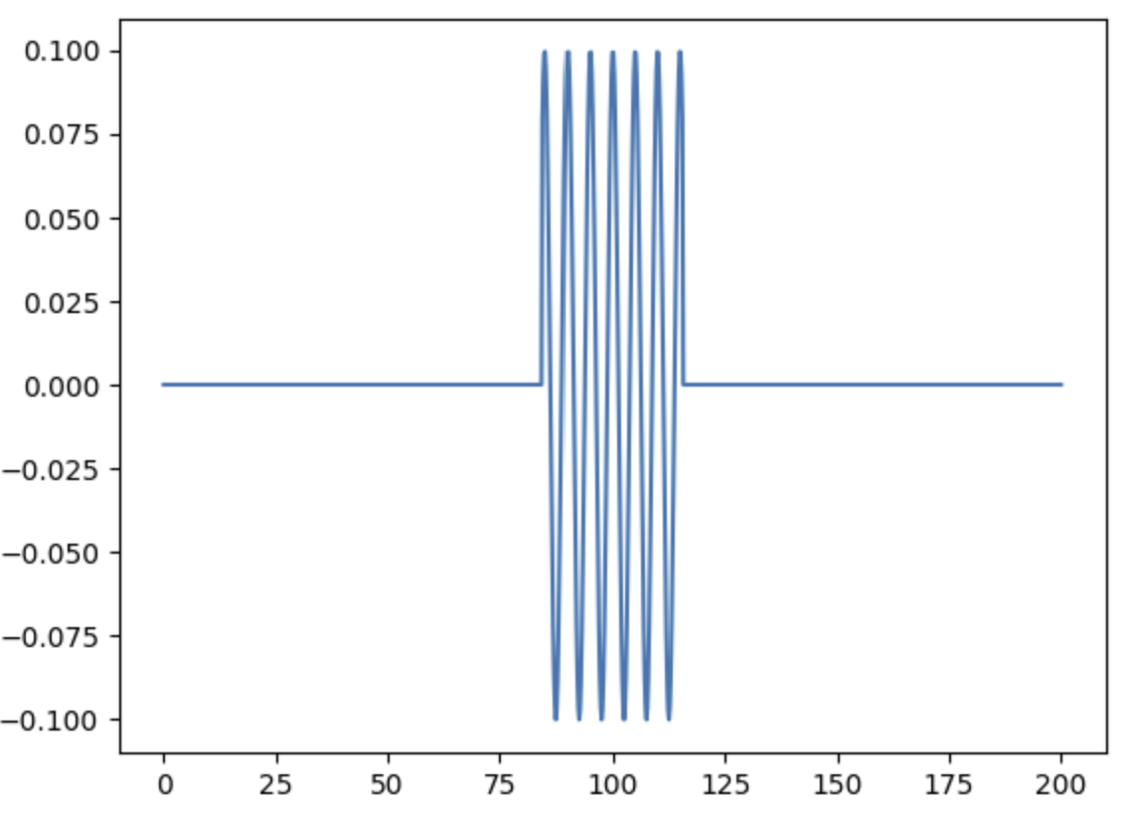
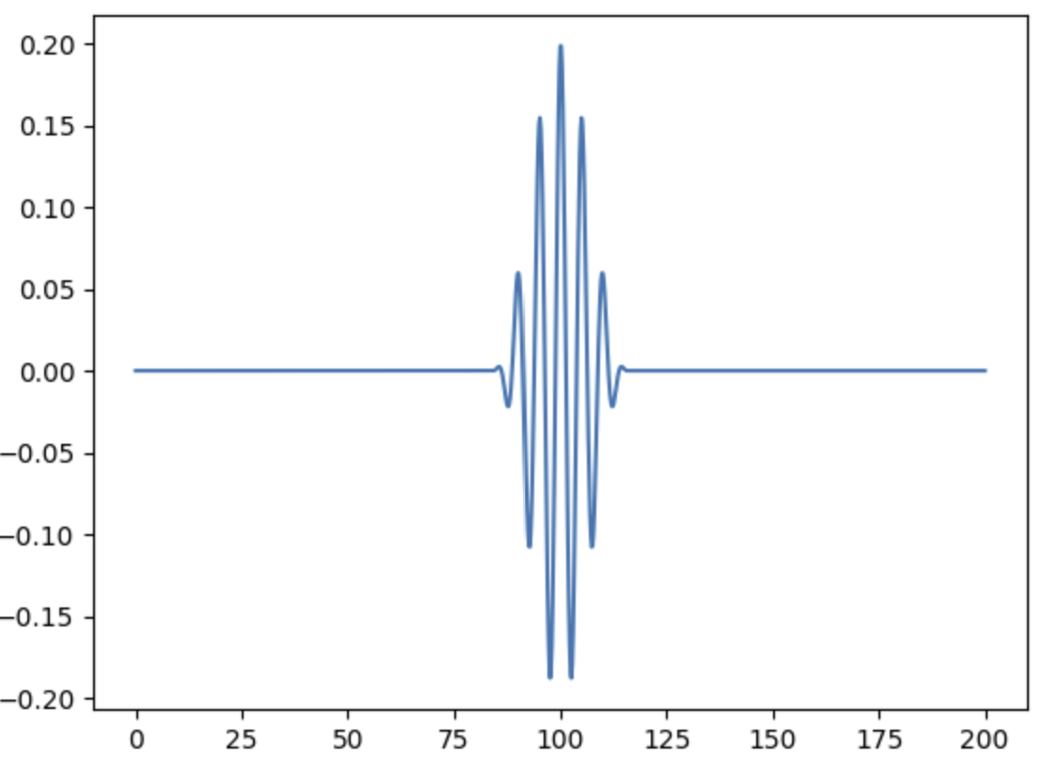
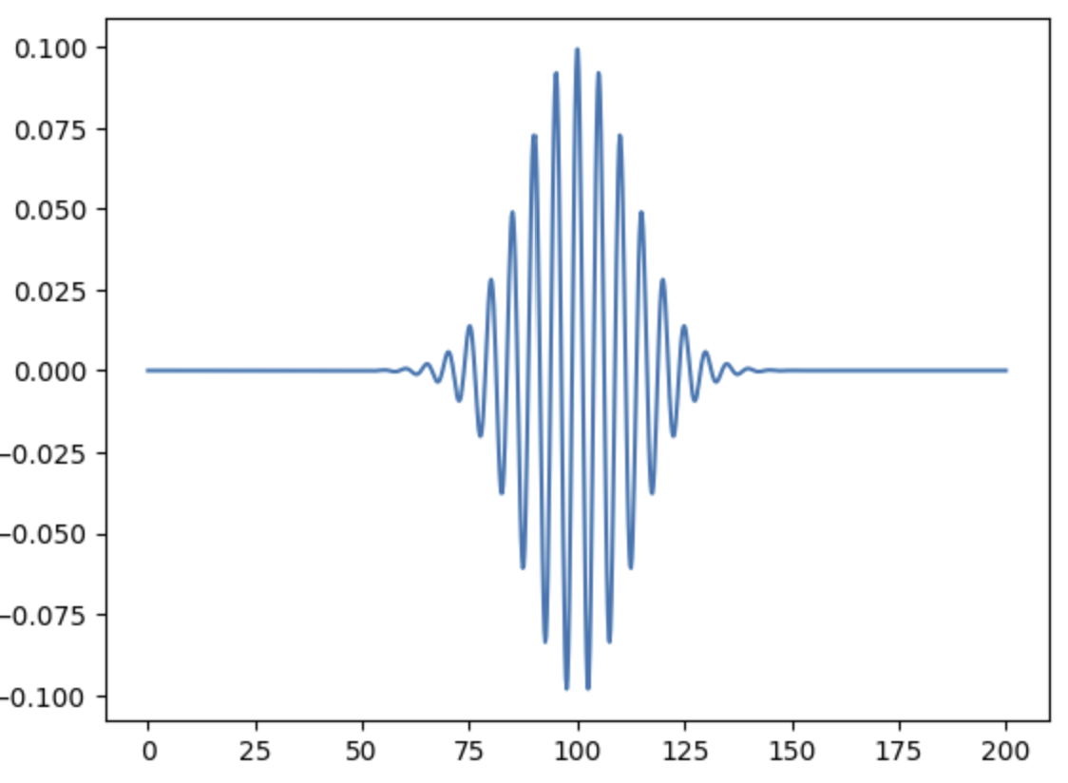
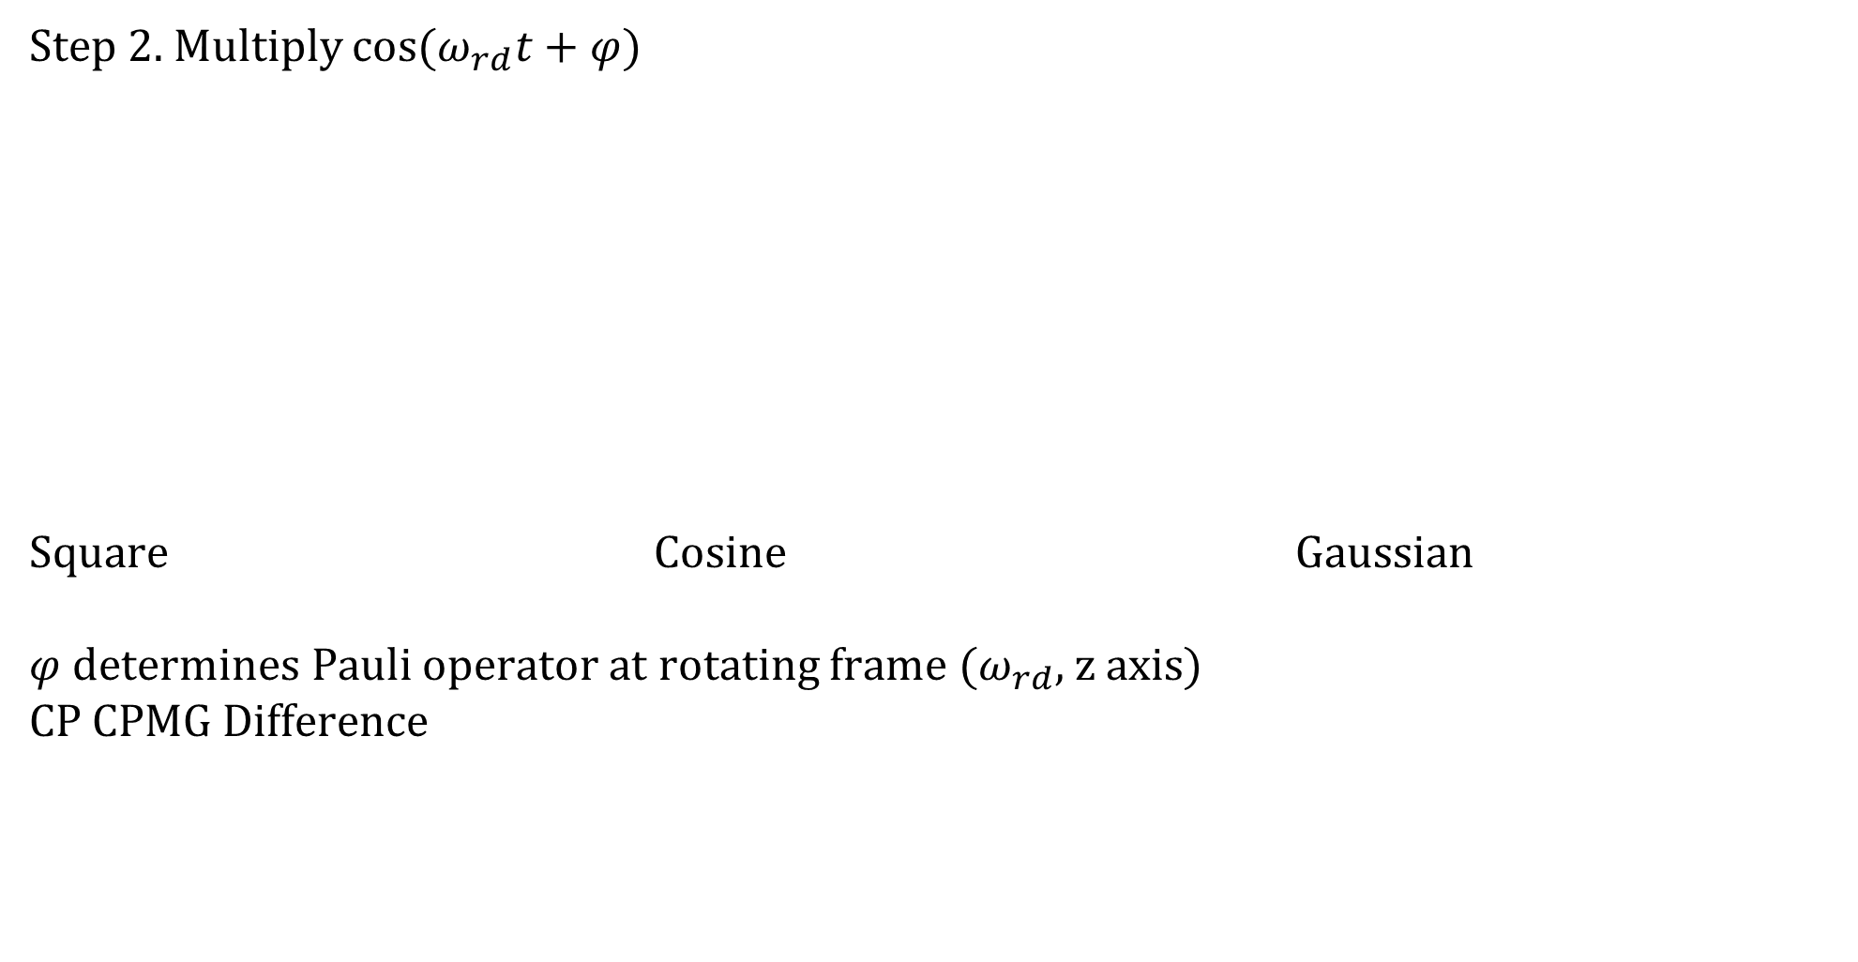
CP CPMG UDD Pulse
Step 2. Multiply $\cos{(ω_{rd}t+φ)}$
Square Cosine Gaussian
$φ$ determines Pauli operator at rotating frame ($ω_{rd}$, z axis)
CP CPMG Difference

Slide 13
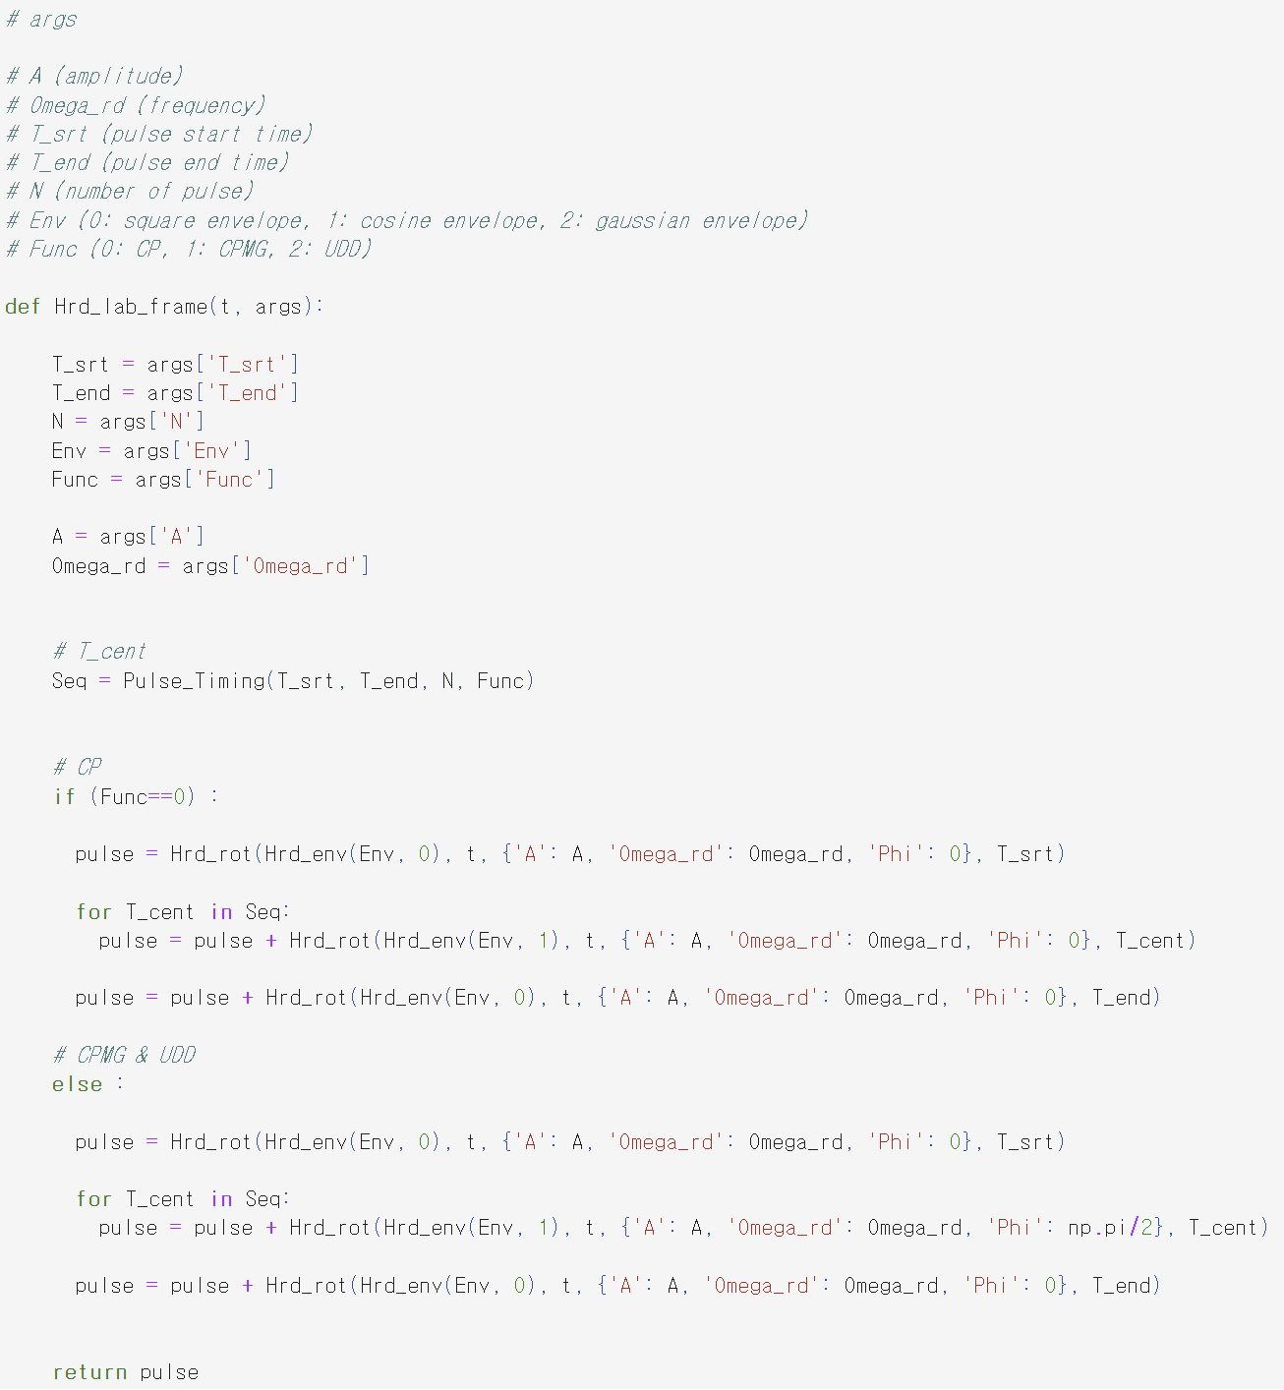
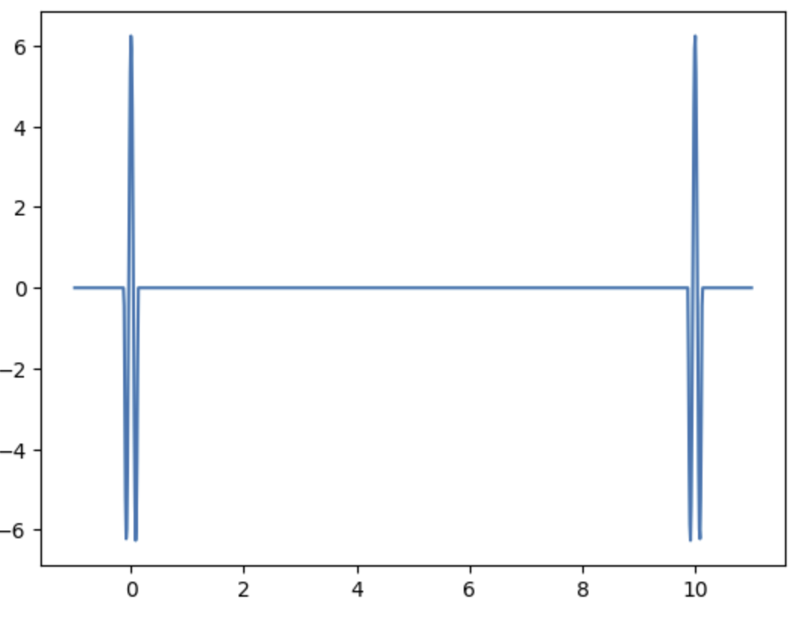
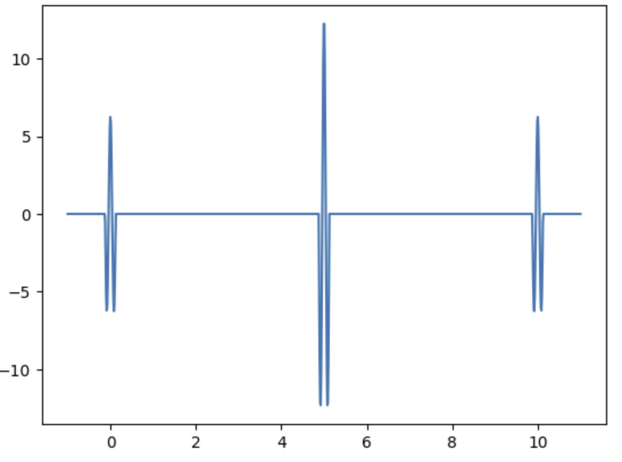
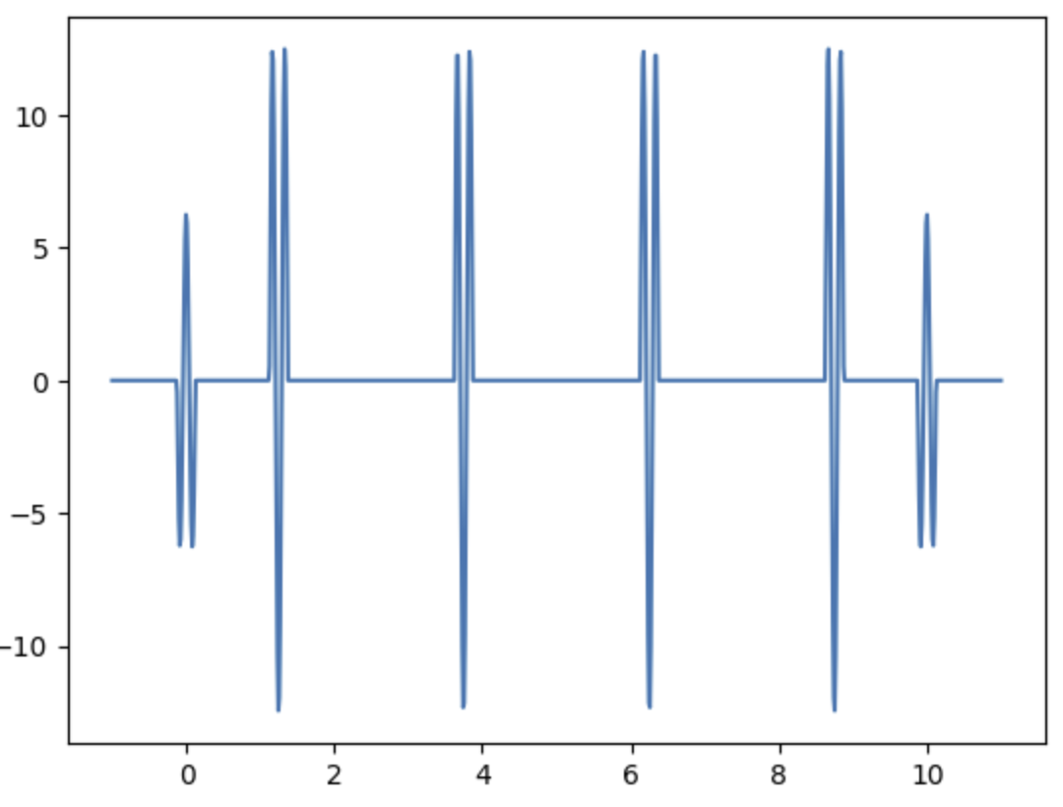
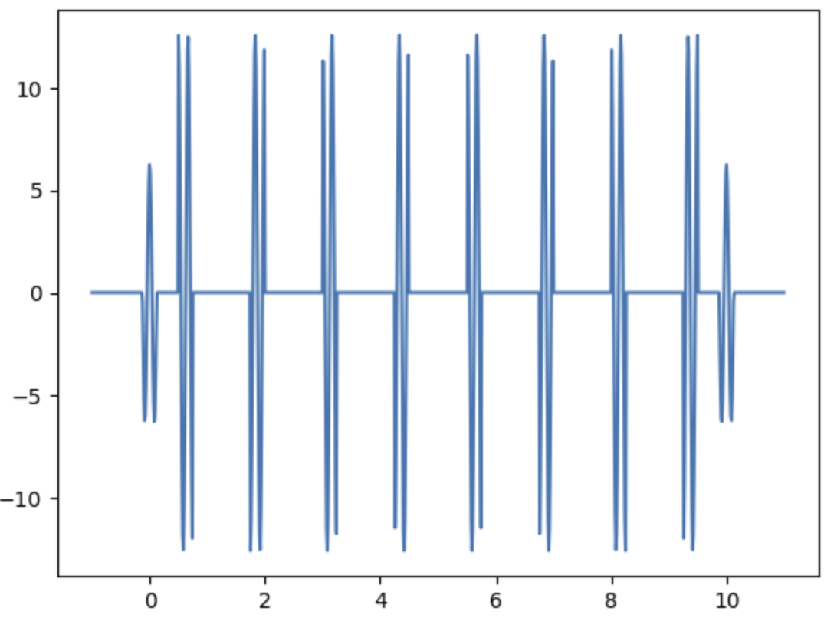
CP CPMG UDD Pulse
Step 3. Arrange each pulse at proper position
N=0 (Ramsey) N=1 (Spin Echo)
N=4 (CP) N=8 (CP)

Slide 14
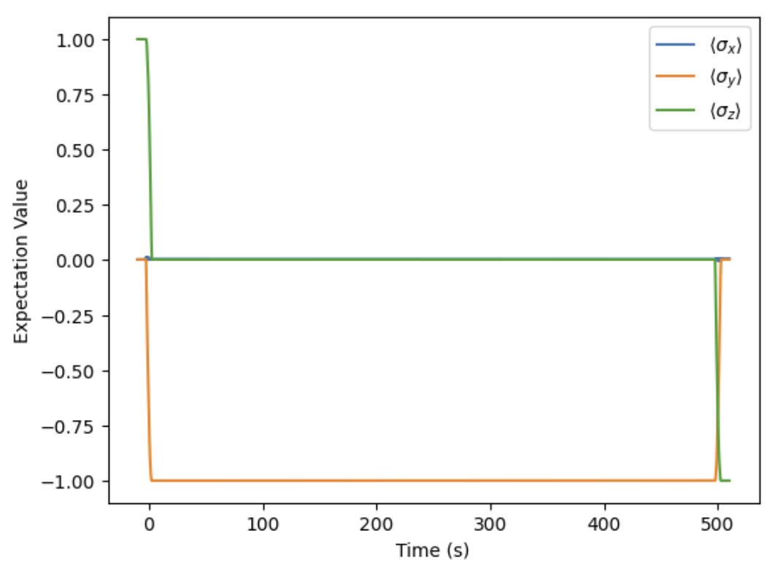
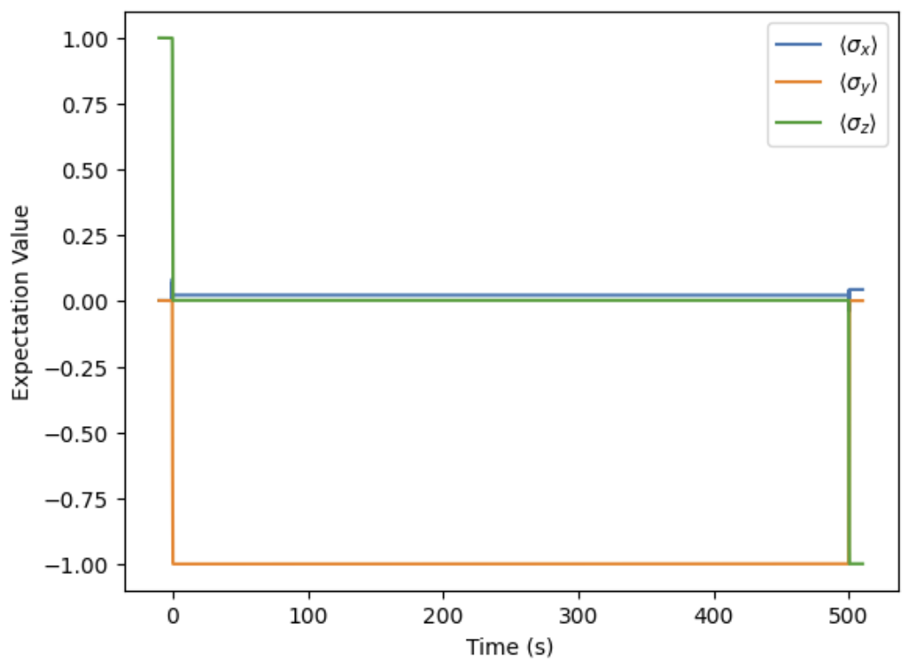
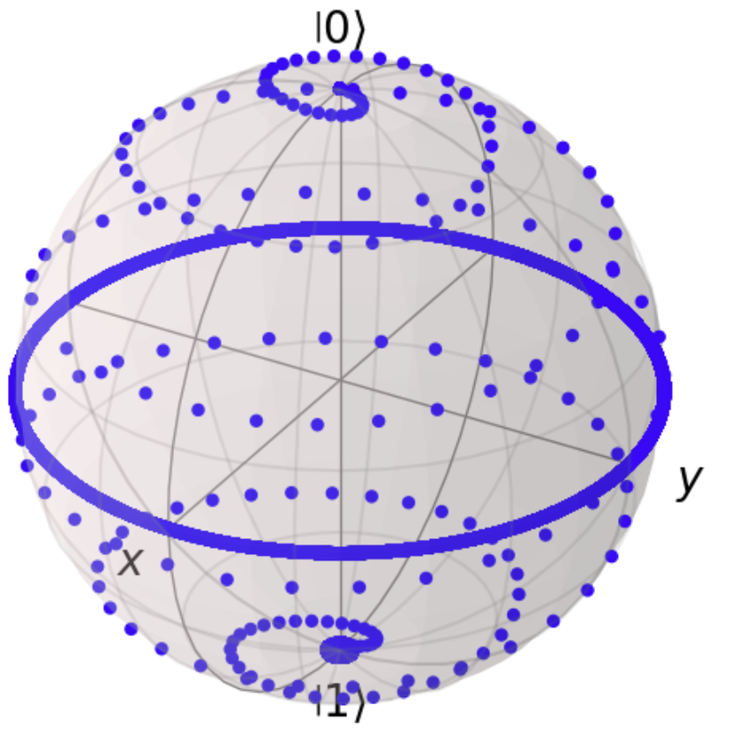
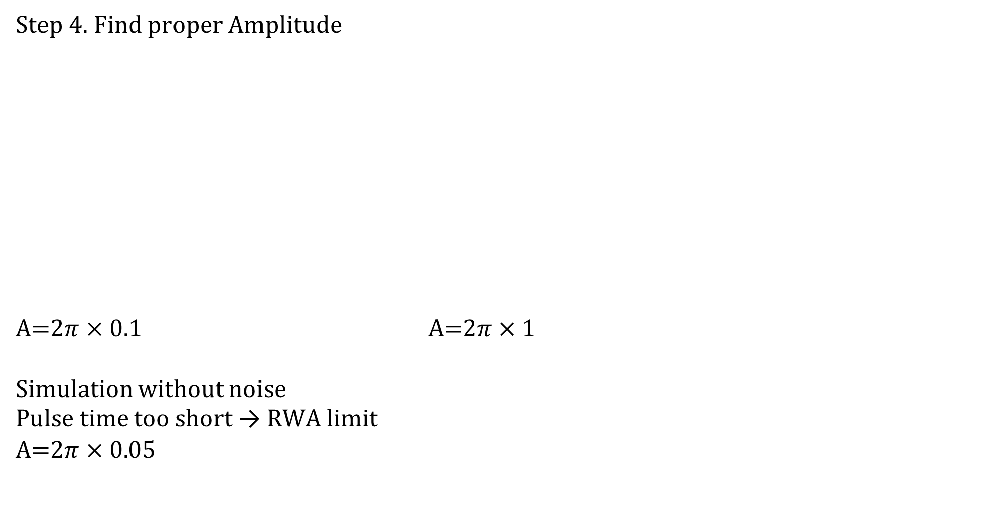
CP CPMG UDD Pulse
Step 4. Find proper Amplitude
A=$2π×0.1$ A=$2π×1$
Simulation without noise
Pulse time too short → RWA limit
A=$2π×0.$05

Slide 15
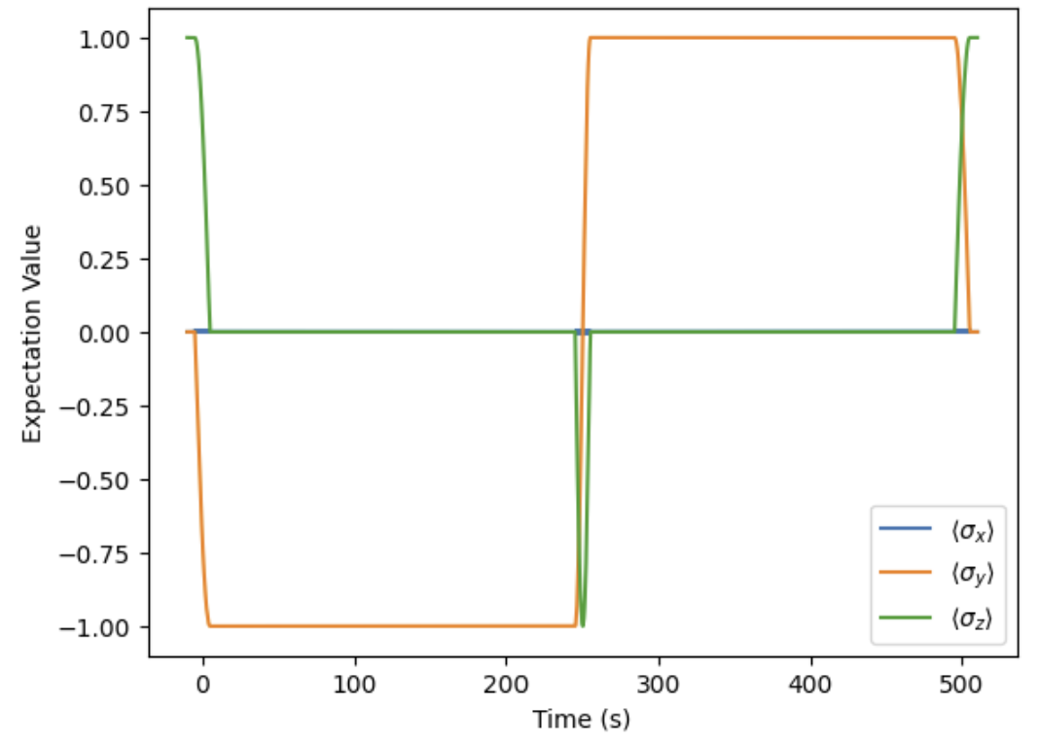
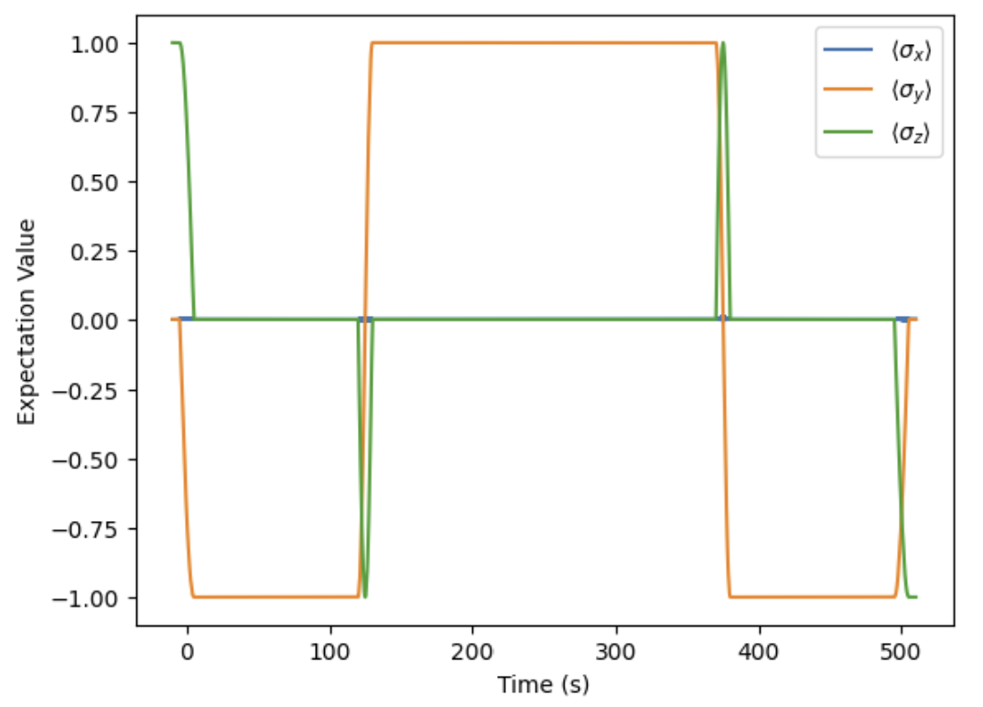
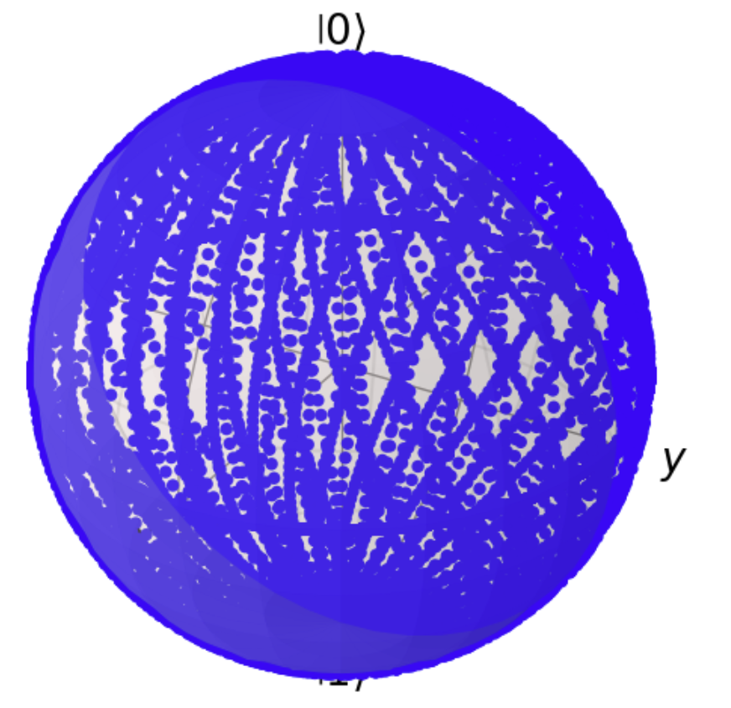
CP CPMG UDD Pulse
Step 5. Find Spin Echo & CP, CPMG
N=1 (Spin Echo) N=2 (CP)

Slide 16
Bloch Redfield Approach

Slide 17
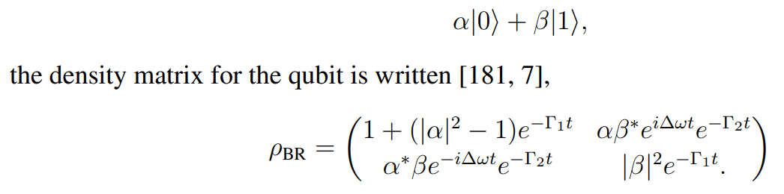
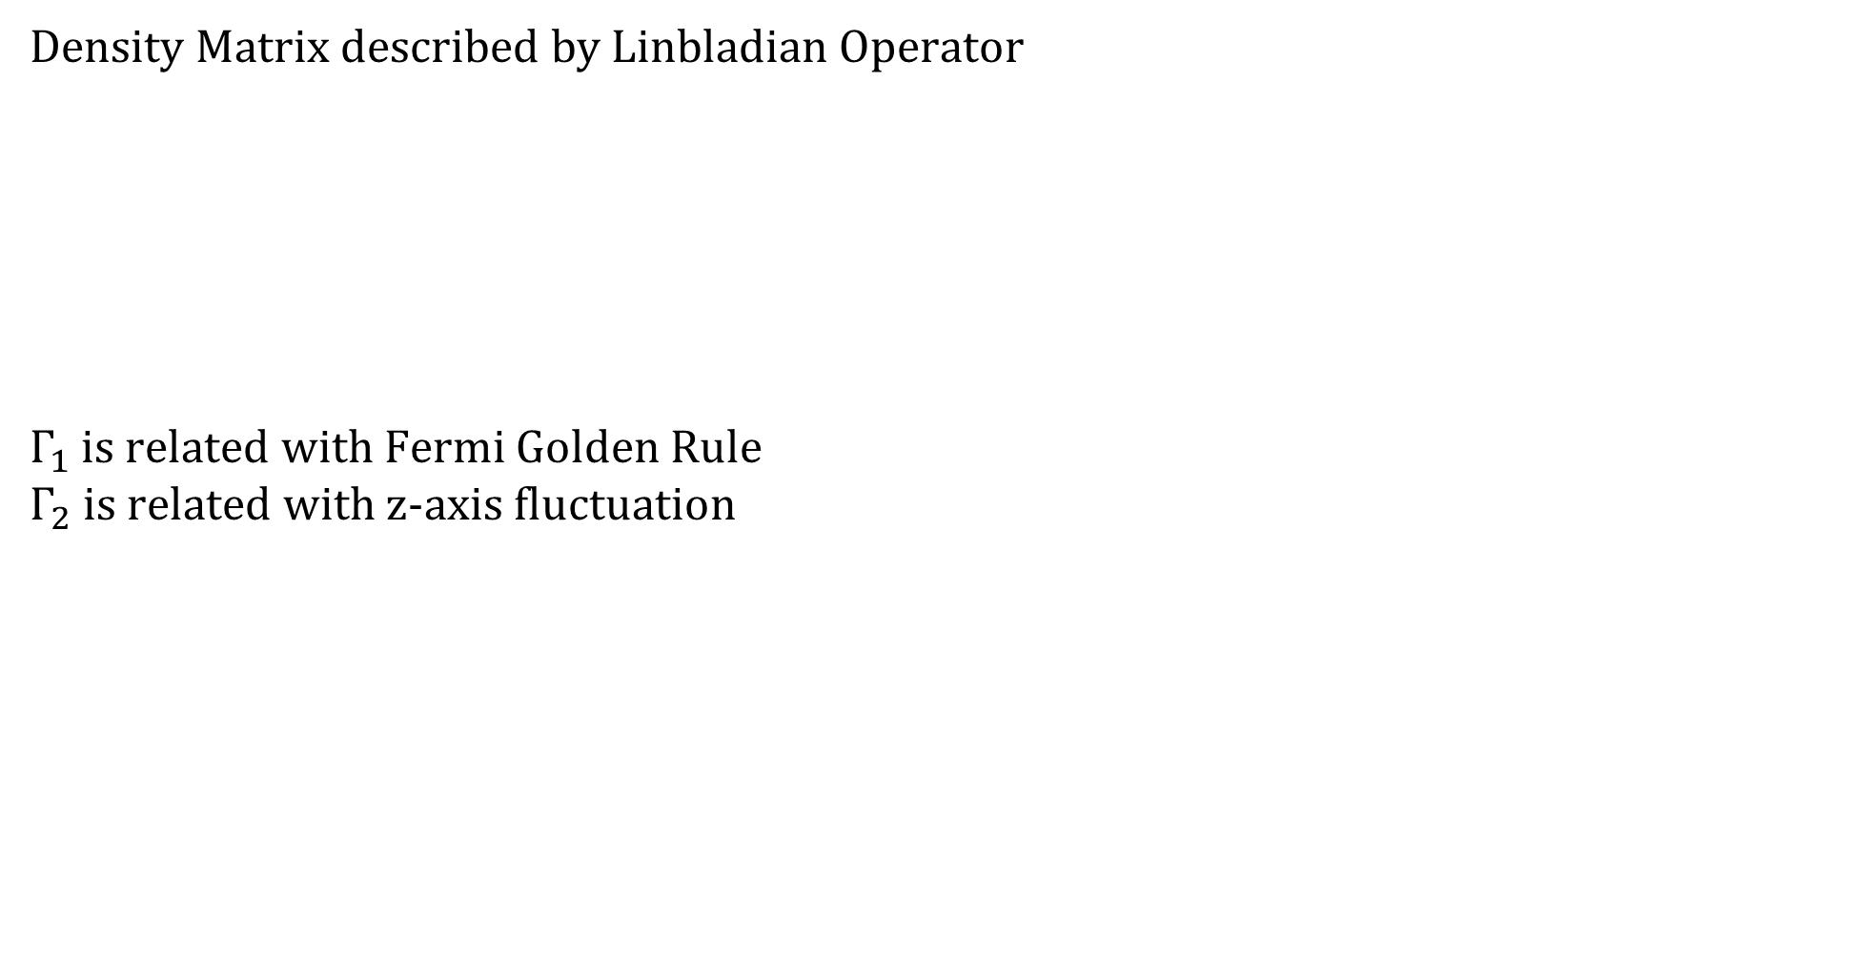
Bloch Redfield Approach
Density Matrix described by Linbladian Operator
$Γ_{1}$ is related with Fermi Golden Rule
$Γ_{2}$ is related with z-axis fluctuation

Slide 18
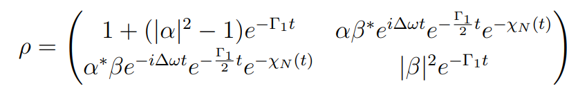
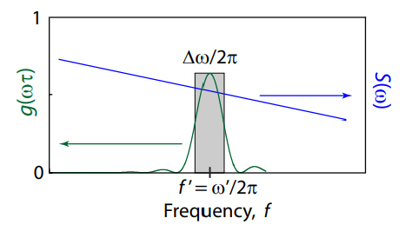
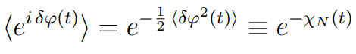
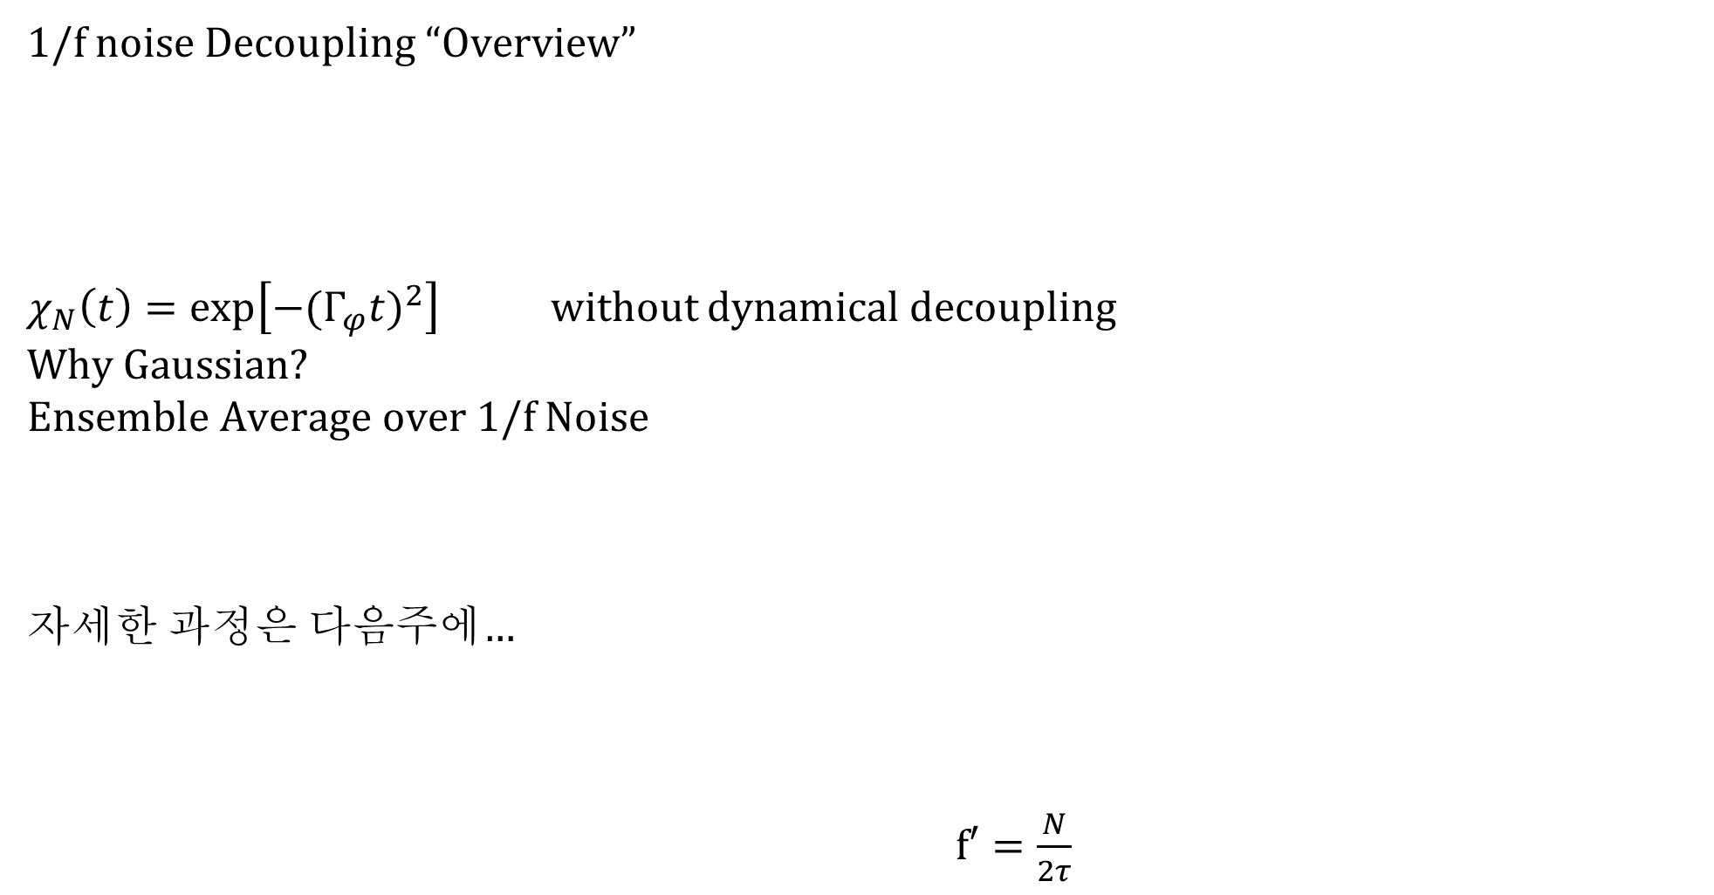
Bloch Redfield Approach
1/f noise Decoupling “Overview”
$χ_{N}\left(t\right)=\exp\left[−{(Γ_{φ}t)}^{2}\right]$ without dynamical decoupling
Why Gaussian?
Ensemble Average over 1/f Noise
자세한 과정은 다음주에…
$f′=\frac{N}{2τ}$

Slide 19
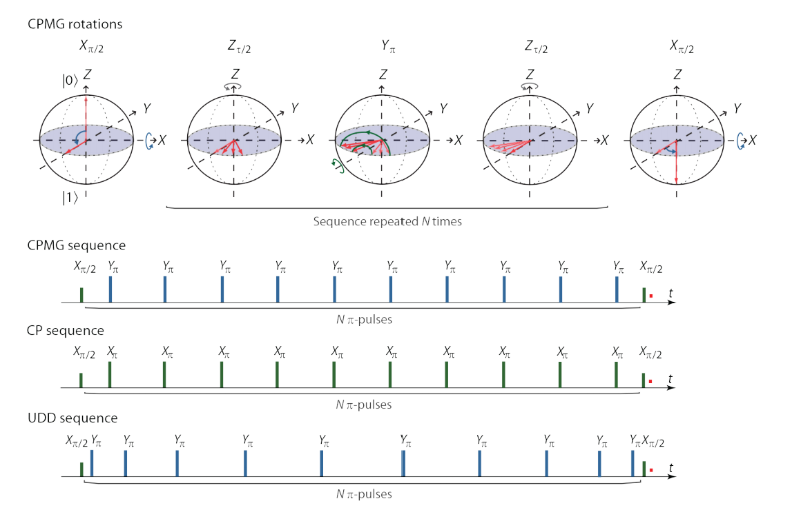
Bloch Redfield Approach

Slide 20
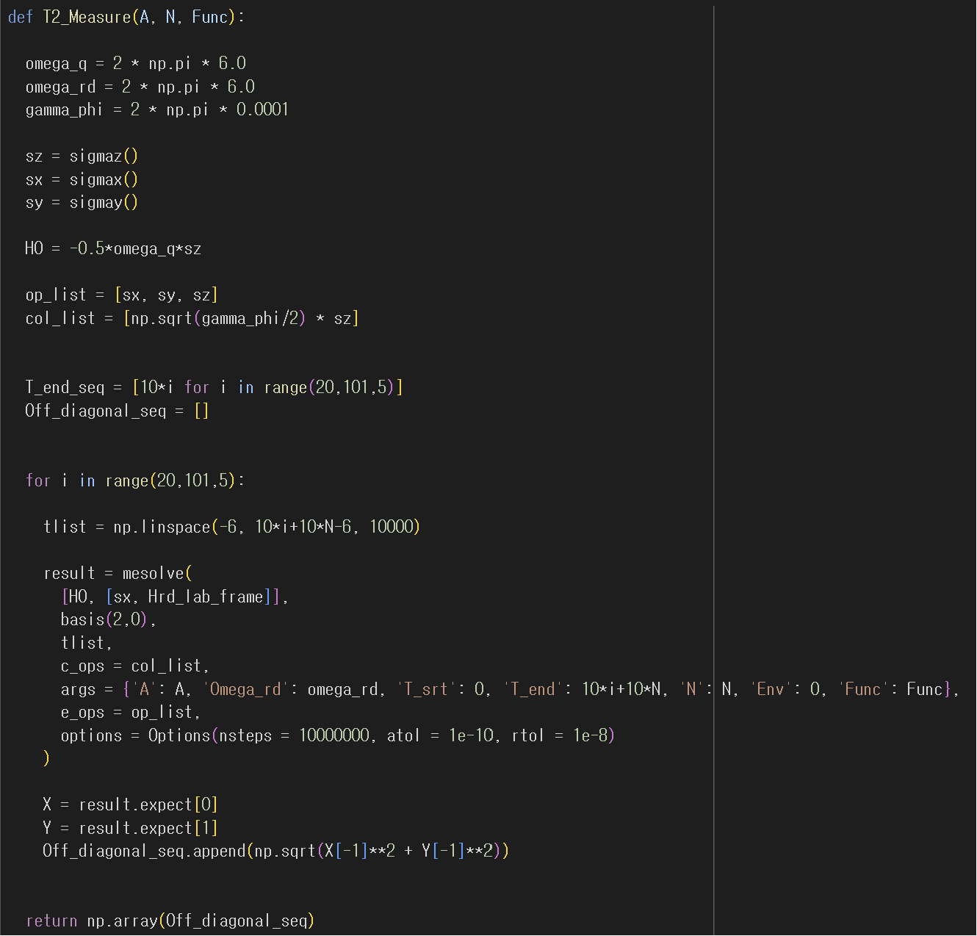
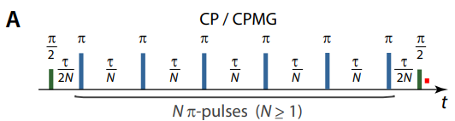
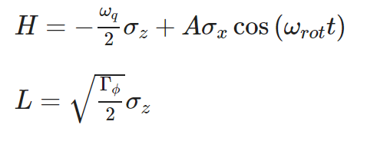
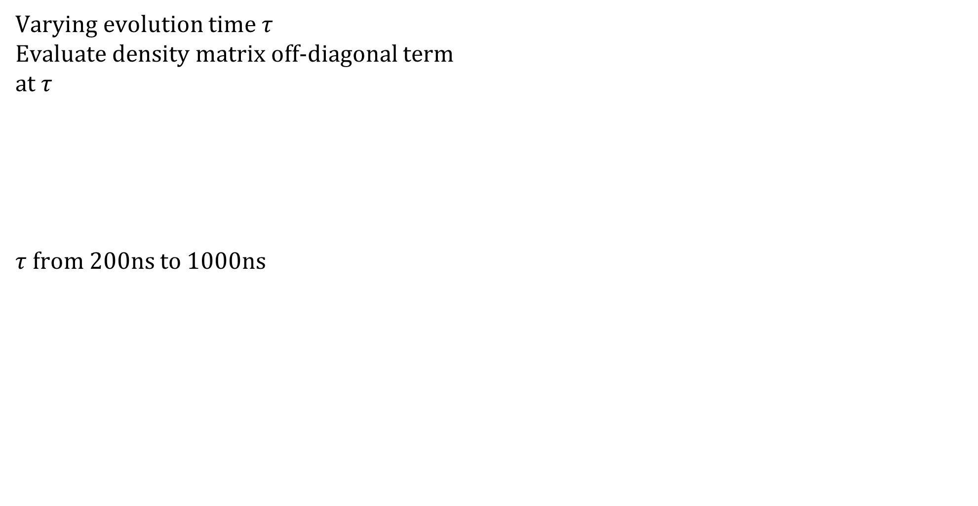
Bloch Redfield Approach
Varying evolution time $τ$
Evaluate density matrix off-diagonal term
at $τ$
$τ$ from 200ns to 1000ns

Slide 21
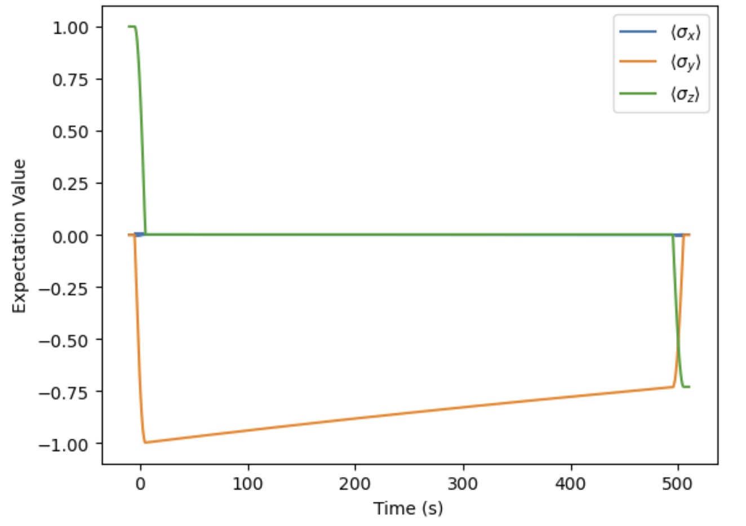
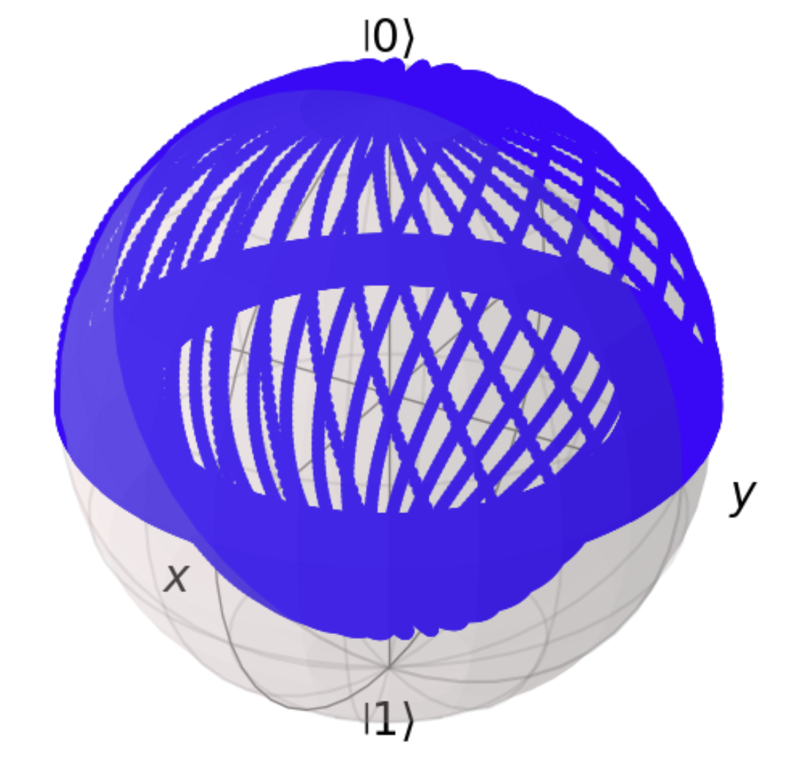
Bloch Redfield Approach
Ramsey (N=0)
Expectation Value Bloch Sphere

Slide 22
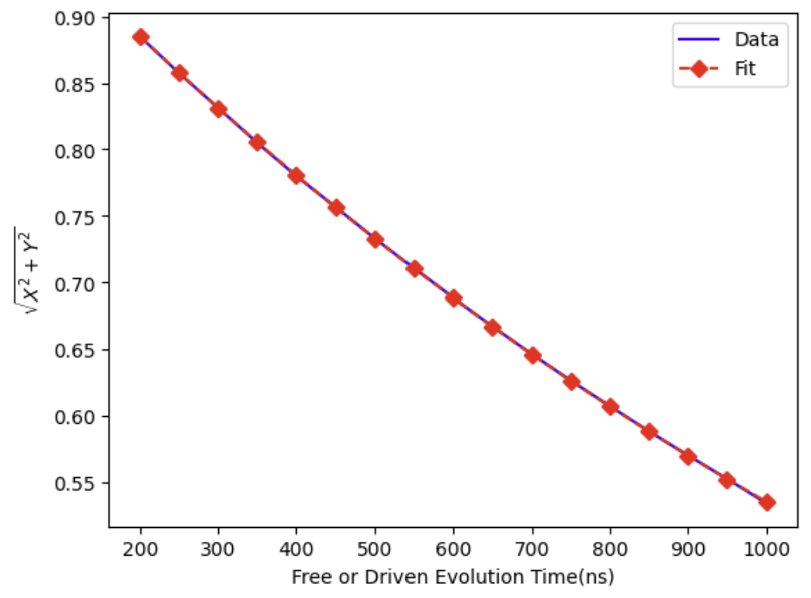
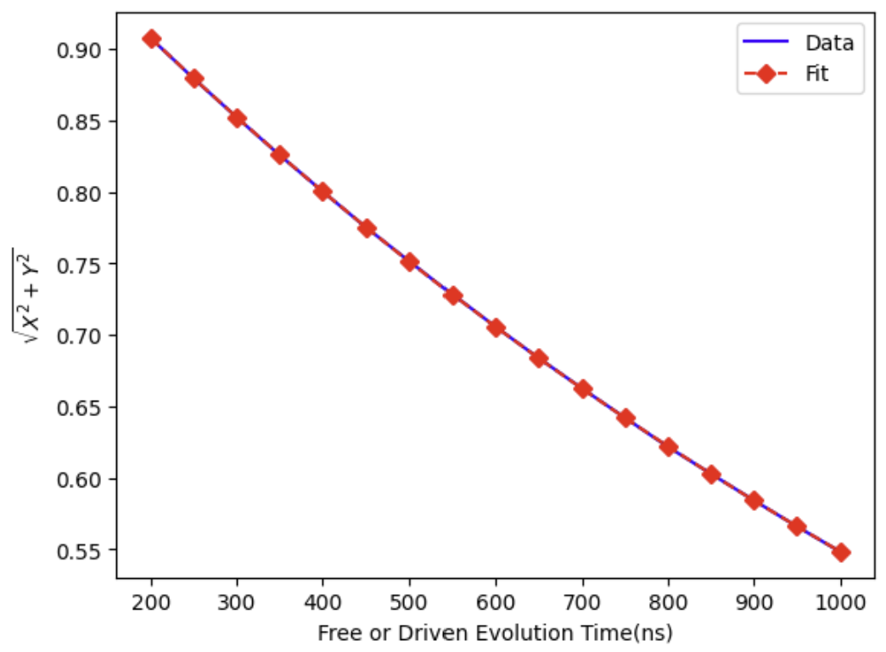
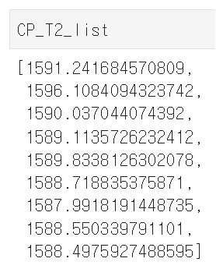
Bloch Redfield Approach
Markovian Noise (=White Noise) dynamical decoupling is impossible
N=0 N=8

Slide 23
Pink Noise Decoupling (not yet)

Slide 24
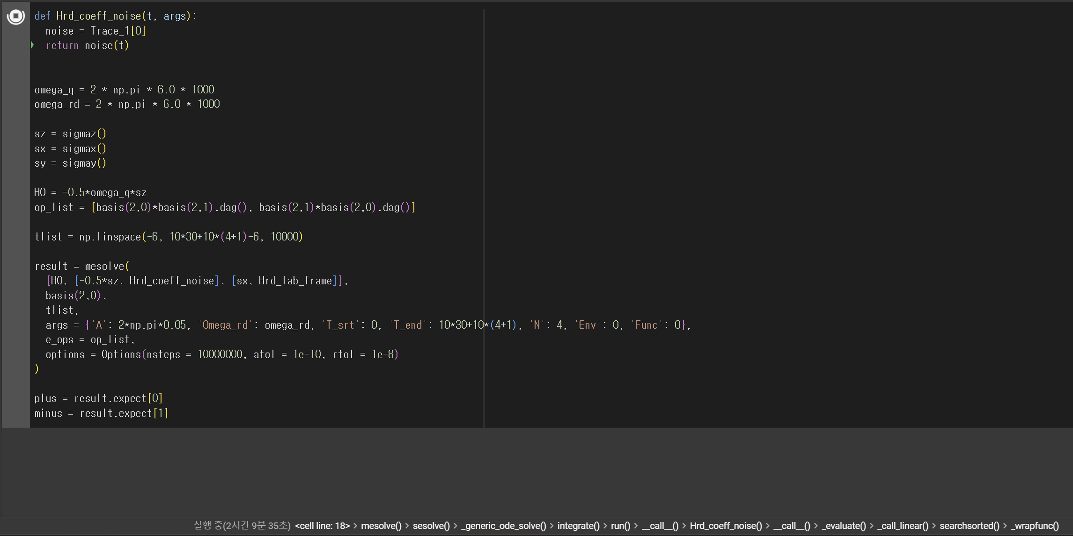
Pink Noise Decoupling (not yet)

Slide 25
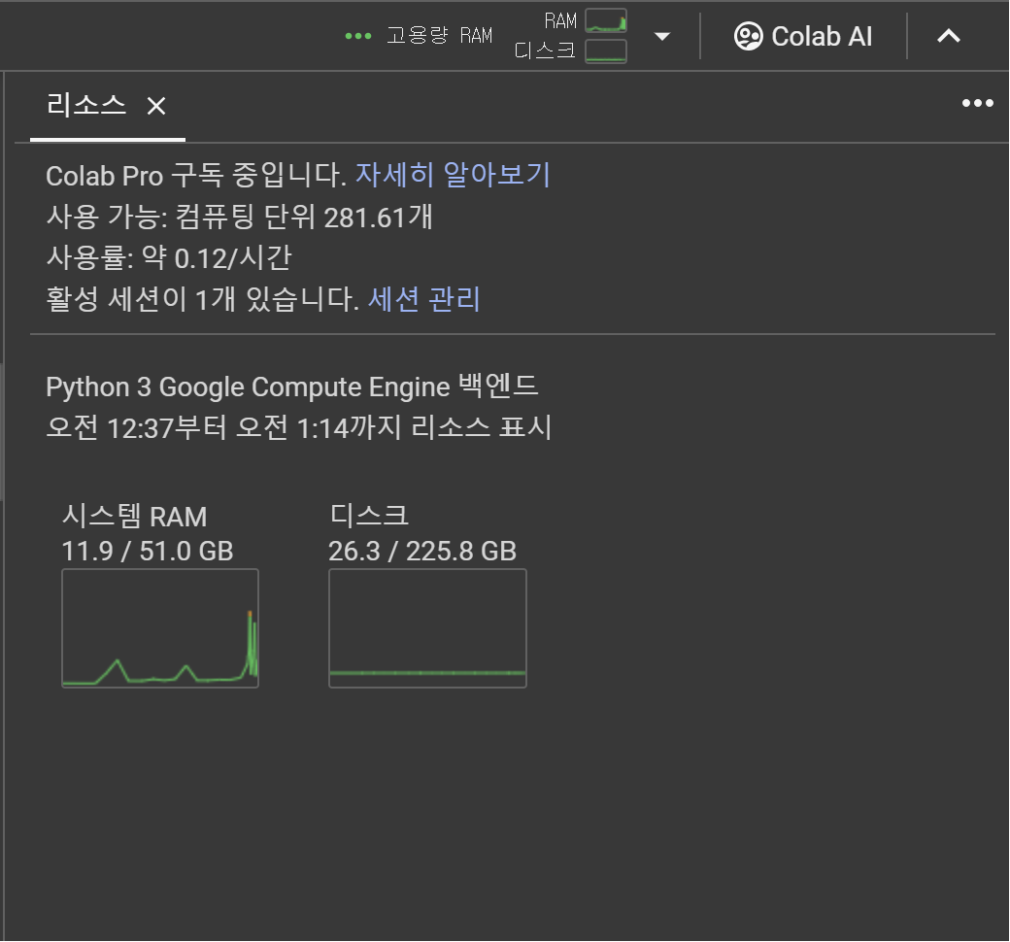
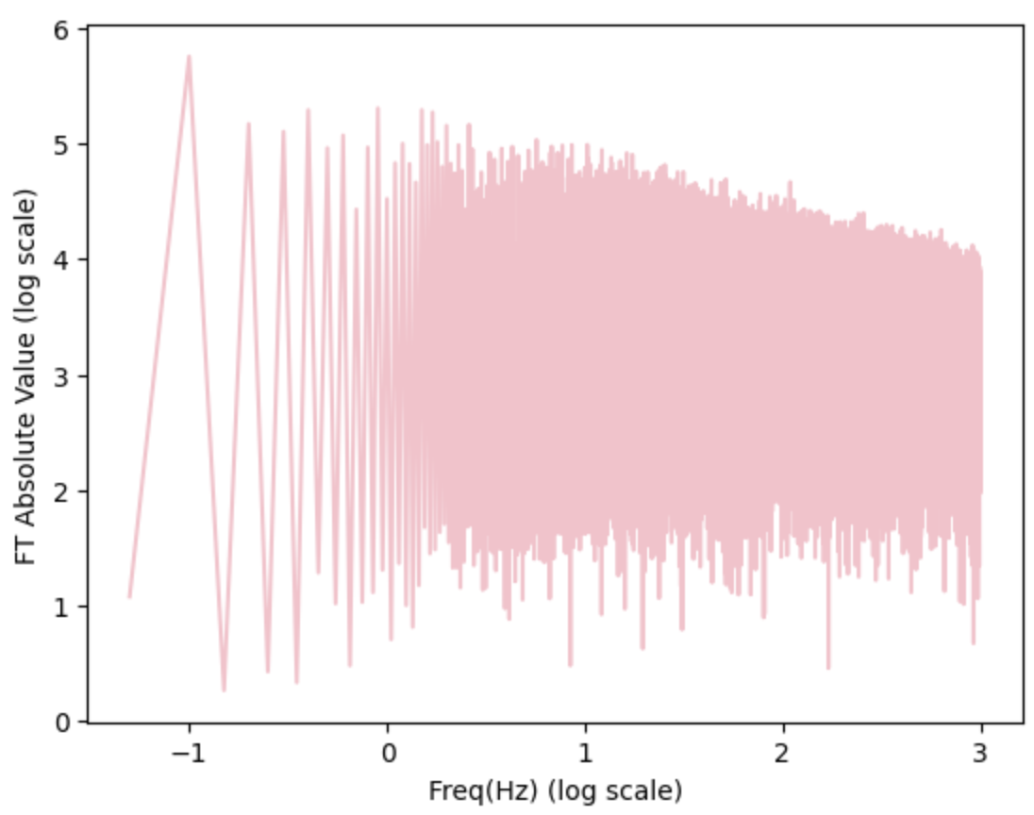
Pink Noise Decoupling (not yet)

Slide 26
Thank you

